Slide 1
Olympic Games Data Analysis
Data Analysis Project for SportssTats
July 2025
Mia Troiano

Slide 2
Proposal Description
This project will analyze data from 100+ years of the Olympic games. This analysis will include various trends on the data such as the teams with the most participating athletes, teams with the most medals, mean athlete age and more. This type of data may be interesting for those on the Olympic Committees, as it shows these trends over many years and can inform them on which countries are top performers. This data may also be used by sports commentators as it gives history of the games to discuss with the fans.

Slide 3
Questions to Answer
Which teams have the most representation and how does this change over time?
Which teams have the most medals and how does this change over time?
What are the mean demographics in each year of the games? How does the age and gender distribution change over time and by team?
Which teams are the top performers in each sport?

Slide 4
Initial Hypotheses
I think that European teams will have the most athlete representation per games in the early years of the games (early 1900s), however the United States, Russia and China will have more athlete representation in the later years and into the 2000s.
Similarly to before, I believe that European teams will have more medals in the early games with the Unites States and China having more medals in the later years. I think China will have the most medals overall within the years from this dataset.
I think the age demographics will show a gradual decline in age of the athletes over the years, with an increase in height and a decrease in weight as athlete body type norms have evolved. I think this will stay pretty consistent by team with no noticeable differences.
I think that teams such as Russia, Canada and Scandanavian countries will dominate the events in the winter sports with a higher total medal count. I think teams such as the United States and China will dominate in summer Olympic sports with a higher total medal count.

Slide 5
Data Analysis Approach
I will be mostly examining the teams, games, medal and sport columns.
I will be using aggregates to examine descriptive statistics of the demographics of the athletes.
I will be using aggregates to count various variables, such as athletes and medals.
I will utilize the chart feature on Snowflake and SourceTable to create a simple visualization with the year of the games on the Y-axis to demonstrate how a variable has changed over the years.

Slide 6
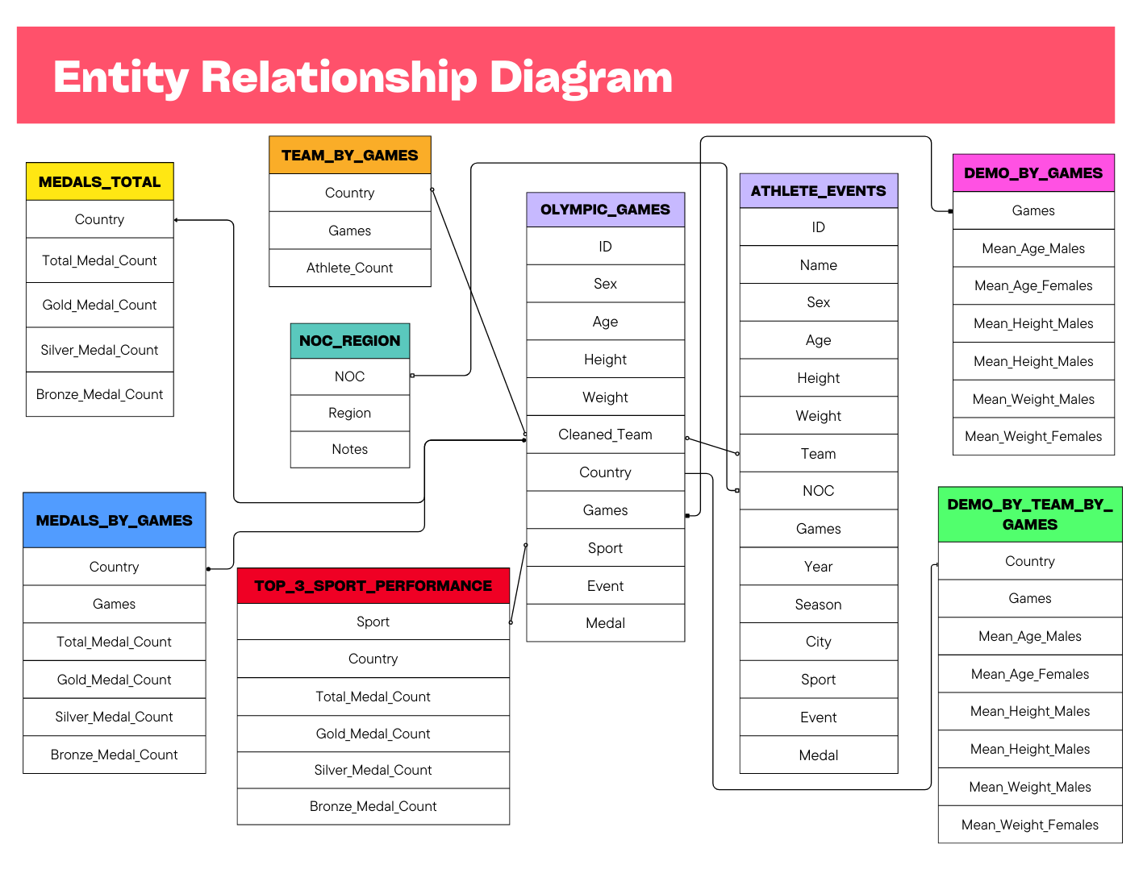
ERD

Slide 7
Technical Difficulties
A difficulty that I ran into was that the 'team' column had to be extensively cleaned, as there were different formats to the same countries and I wanted to make sure all versions were accounted for in the analysis
Other difficulties arose with multiple columns containing either 'null' or 'n/a', which needed to be screened out for any mathematical analysis

Slide 8
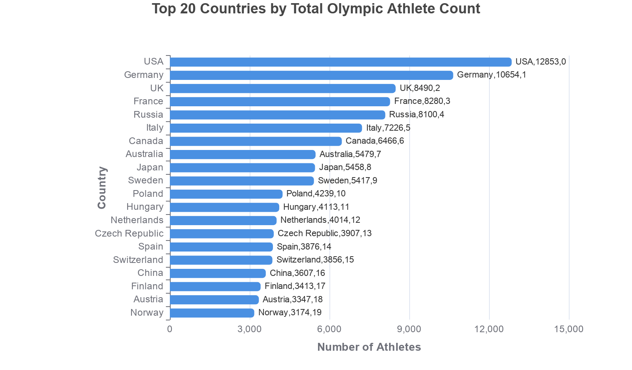
Initial Findings – Team Representation
USA, Germany and UK dominated representation in the Olympics over the span from 1896 to 2016, including 51 different games
European countries dominate the top 20 list, with 14 in the top 20

Slide 9
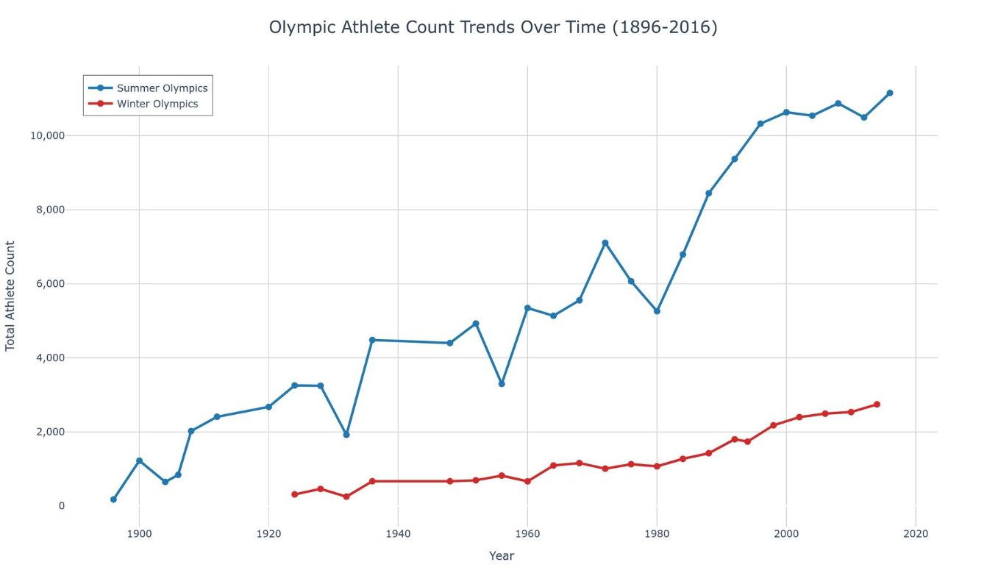
Initial Findings – Team Representation
Growth in representation is seen in both the Winter and Summer Olympics over the years, with a greater growth rate seen in the Summer games
Major dips in participation can be seen around major historical events, such as the Great Depression, post-war time and boycotts
The greatest representation was seen in the Summer 2016 Olympic games

Slide 10
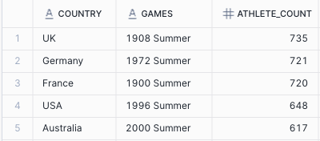
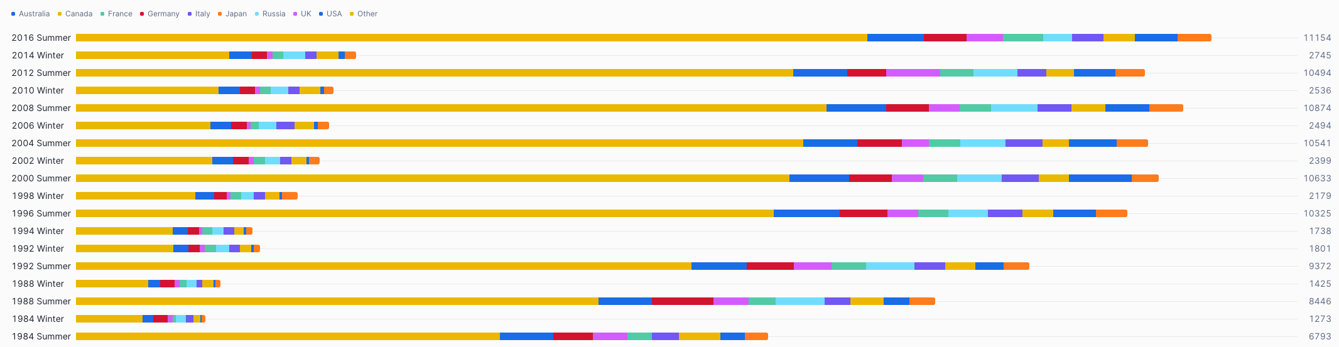
Team Representation by Games
The UK had the greatest athlete representation to date, sending 735 athletes to the 1908 Summer Olympics

Slide 11
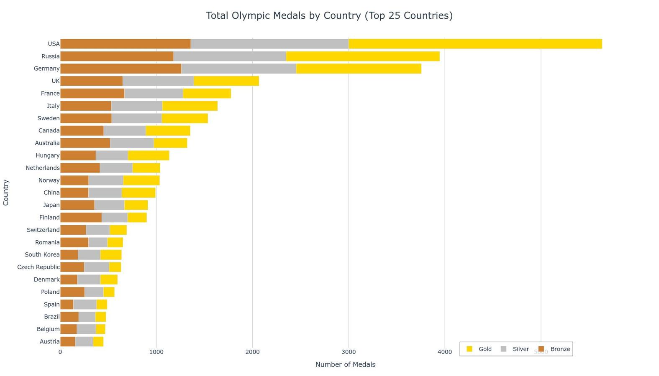
Total Medal Count
USA dominates the Olympic Medal rankings, with 5,637 total medals won
European countries make up 15 of the top 25 countries with the most medals won
It should be noted that this is total medals, not broken down by Winter and Summer Games

Slide 12
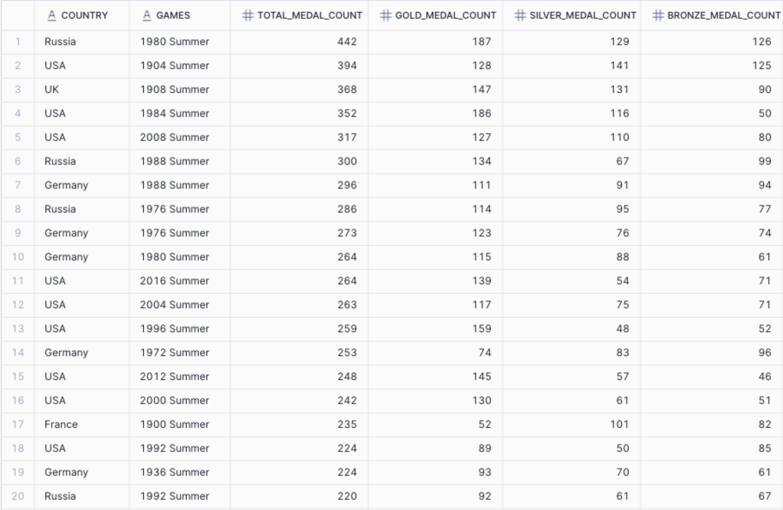
Medal Count By Games
Despite having the second most overall medals, Russia has won the most medals, along with most gold medals, at a single games: the 1980 Summer Olympics
Russia, USA, UK and Germany make up nearly all of the top 20 of the most medals won in a single games

Slide 13
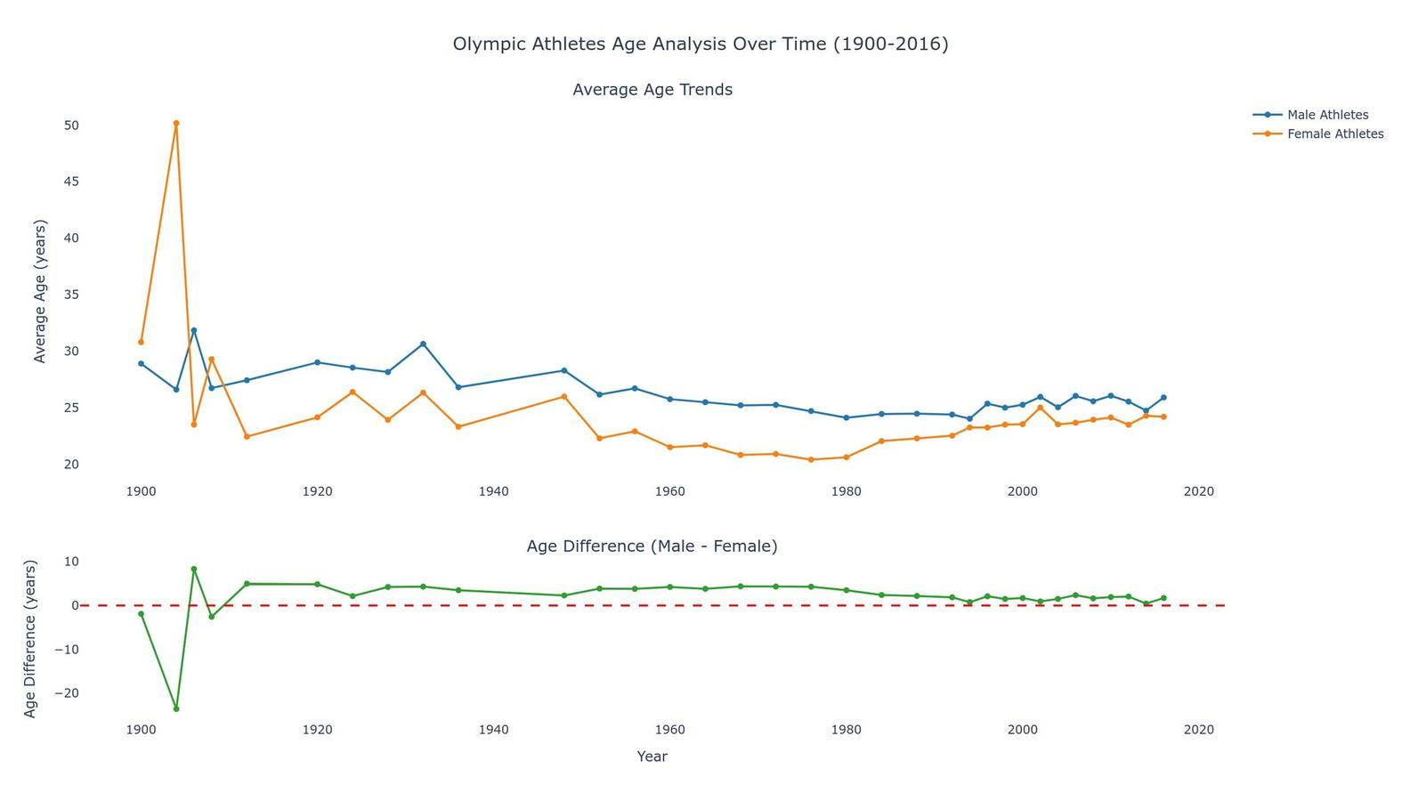
Athlete Demographics - Age
Average male athlete age is slightly older (26.3 years) than female athletes (24.4)
Age differences are converging for male and female athletes, showing ages are becoming more similar over time
Male athletes are getting slightly younger while female athletes are getting slightly older

Slide 14
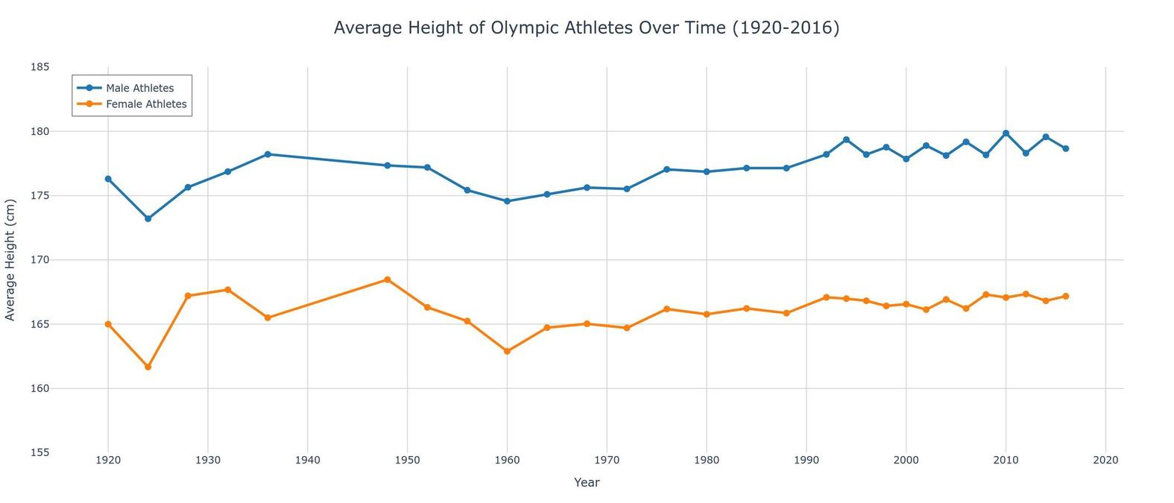
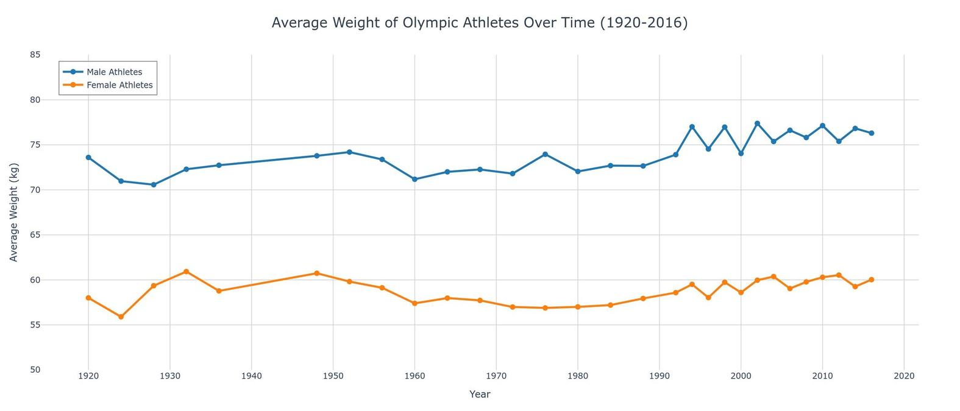
Athlete Demographics - Height and Weight
Male athletes tend to be an average of 11.2cm taller and 15.2kg heavier than female athletes
Both genders are getting taller and heavier over time, with height increasing more gradual than weight

Slide 15
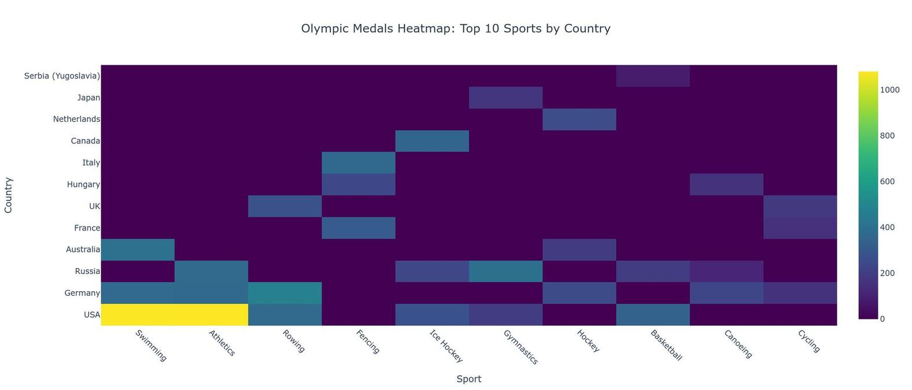
Top Performers By Sporting Event
USA dominates in swimming, athletics and basketball
Germany dominates in rowing and canoeing
Italy dominates in fencing
Canada dominates in ice hockey
Russia dominates in gymnastics

Slide 16
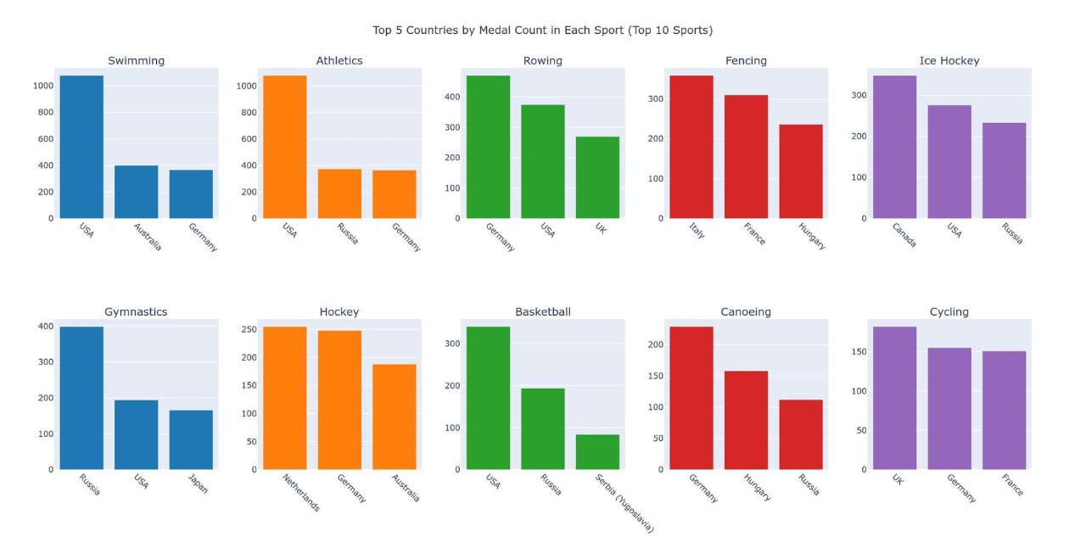
Top Performers By Sporting Event
USA and Germany are amongst the top 3 medal count for 6 of the 10 top sports
Russia is amongst the top 3 medal count for 5 of the 10 top sports

Slide 17
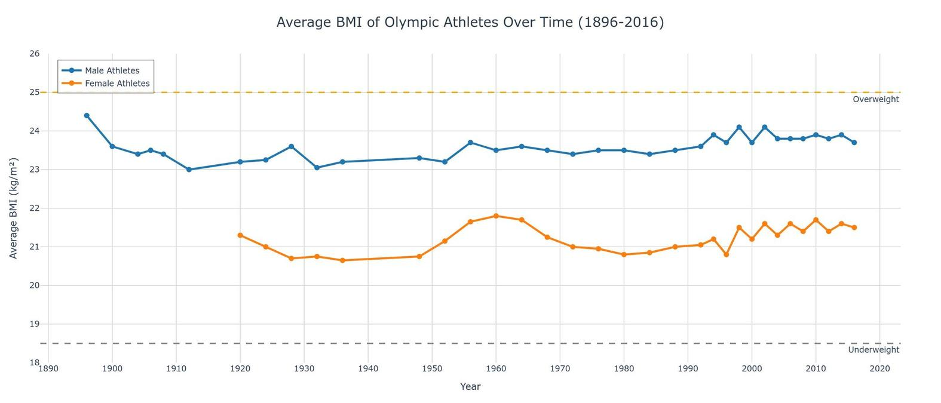
New Metric – Body Mass Index (BMI)
Average BMI was used to examine population level body composition, with the assumption that BMI would decrease over the years as a leaner body composition was preferable for athletes
The trend shows that there isn't much change in the average BMI over the years of the games
Males tend to have a higher BMI than females, with both average BMIs falling well within healthy normal standards

Slide 18
Final Findings
The United States, Germany, the United Kingdom, and France were among the leaders in total representation at the Olympics, as well as among the leaders in representation at a single Olympic games
Despite being 5th in total representation at the Olympics, Russia has the second most medals won; second to the United States. My hypothesis that China would have the most medals won over the years was incorrect, as they ranked 13th in most medals won
Average athlete demographics have changed throughout the years, with age for males getting younger and age for females getting older. Height and weight for both males and females have been increasing, which disproves my initial hypothesis
The United States, Germany and Russia are consistently good at the top sporting events in the Olympics, whether it is the Summer or Winter sporting events

Slide 19
Further Directions
This analysis focused on exploratory data analysis with descriptive statistics
Further analysis can focus on trends to help predict future athlete participation, possible medal placement, athlete demographics and more, which can be used for a variety of planning or betting opportunities
Sports betting companies can use these predictive trends as a guideline for how to wager their bets for the Olympics
Analysis can also look into relationships such as a country's success in the games when they are the host nation, which can be used to drive countries to place bids to host the Olympics

